Slide 1
Team 5
Identifying Structural
Hiring Difficulties
in Singapore
1,026,576
cleaned job records
Oct 2022–May 2024
analysis period
Persona C
government workforce planner
Using job posting data to detect persistent labour supply–demand mismatch
Verified source: hackathon-team-5.ipynb
0:00–0:30 • 1/12
Notes:
Summary: - Introduce the project as a data storytelling presentation for government workforce planning. Main data highlights: - Cleaned dataset contains 1,026,576 job records. - Analysis period runs from October 2022 to May 2024. - Persona is Government Workforce Planner, labelled Persona C. Speaker points: - Open with the policy objective: detect structural hiring difficulty. - Position the presentation as evidence-led, not anecdotal. - Avoid over-explaining methods on this opening slide.

Slide 2
The Workforce Planning Problem
Why this matters for retraining grants and labour policy
Problem statement
Research questions
Which sectors have the highest hiring difficulty?
Does position level affect hiring difficulty?
Which roles have high vacancies but low applicants?
What are the top 5 hardest-to-fill sectors?
The Ministry of Manpower lacks a data-driven framework to identify and quantify structural hiring difficulties across sectors and job roles, limiting its ability to prioritise retraining grants for areas facing persistent labour supply–demand mismatches.
Verified source: hackathon-team-5.ipynb
0:30–1:15 • 2/12
Notes:
Summary: - Frame the business problem before showing analysis. Main data highlights: - The presentation investigates structural hiring difficulty across sectors and roles. - Focus is on labour supply–demand mismatch and grant prioritisation. Speaker points: - Explain that temporary vacancies are different from structural hiring difficulty. - Emphasise that policy resources should be prioritised with evidence. - Transition by saying the next slide shows how the dataset was prepared.

Slide 3
Building a Reliable Analytical Base
Data cleaning before insight generation
1,048,585
22
1,026,576
3 Oct 22–29 May 24
raw rows
raw columns
cleaned records
posting date range
Code used to validate the cleaned dataset
Cleaning workflow
df['metadata_originalPostingDate'] = pd.to_datetime(df['metadata_originalPostingDate'])
df['metadata_newPostingDate'] = pd.to_datetime(df['metadata_newPostingDate'])
df['metadata_expiryDate'] = pd.to_datetime(df['metadata_expiryDate'])
print(df_clean.shape)
print(df_clean['metadata_originalPostingDate'].min(), df_clean['metadata_originalPostingDate'].max())
print(df_clean['metadata_jobPostId'].nunique())
Converted posting dates into datetime format
Reviewed null counts and basic statistics
Removed salary outliers using 99th percentile logic
Created cleaned DataFrame for analysis
Validated cleaned shape and unique job post IDs
Verified source: hackathon-team-5.ipynb
1:15–2:05 • 3/12
Notes:
Summary: - Show that the analysis is built on a cleaned and validated dataset. Main data highlights: - Raw dataset: 1,048,585 rows and 22 columns. - Cleaned dataset: 1,026,576 records. - Date range: 3 October 2022 to 29 May 2024. - Unique job post IDs after cleaning: 1,026,576. Speaker points: - Keep the explanation simple for a non-technical audience. - Mention date conversion, missing values, outlier review and cleaned validation. - Emphasise that the cleaned dataset is the foundation for all subsequent scores.

Slide 4
Creating a Hiring Difficulty Score
Combining demand pressure and applicant response into one index
1
Normalised
repost count
2
Normalised
number of vacancies
3
Inverse-normalised
applications
Difficulty score code
Higher score = harder to fill
The score is the average of the three normalised components. Lower application volume increases the score because it signals weaker candidate response.
def normalize(col):
return (col - col.min()) / (col.max() - col.min())
repost_norm = normalize(df_clean['metadata_repostCount'])
vacancies_norm = normalize(df_clean['numberOfVacancies'])
apps_norm = 1 - normalize(df_clean['metadata_totalNumberJobApplication'])
df_clean['hiring_difficulty_score'] = (repost_norm + vacancies_norm + apps_norm) / 3
Verified source: hackathon-team-5.ipynb
2:05–2:50 • 4/12
Notes:
Summary: - Explain the scoring approach in business terms. Main data highlights: - Difficulty score combines repost count, vacancies and low applications. - Variables are normalised to a 0–1 scale. - Applications are inverse-normalised so fewer applications increase difficulty. Speaker points: - Say the index allows consistent comparison across sectors and position levels. - Avoid going too deep into formula mechanics. - Transition to sector-level results.

Slide 5
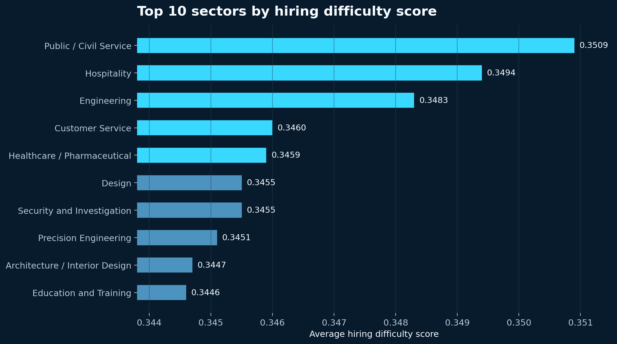
Insight 1: Some Sectors Show Structural Hiring Difficulty
Ranked by average hiring difficulty score
Top sector signals
Rank
Sector
Score
1
Public / Civil Service
0.3509
2
Hospitality
0.3494
3
Engineering
0.3483
4
Customer Service
0.3460
5
Healthcare / Pharmaceutical
0.3459
Interpretation
The highest-scoring sectors combine repeated reposting, vacancy pressure and weaker applicant response.
Verified source: hackathon-team-5.ipynb
2:50–4:10 • 5/12
Notes:
Summary: - Present the first major insight: hiring difficulty differs by sector. Main data highlights: - Public / Civil Service: 0.3509. - Hospitality: 0.3494. - Engineering: 0.3483. - Customer Service: 0.3460. - Healthcare / Pharmaceutical: 0.3459. Speaker points: - Explain that these are average difficulty scores by primary category. - Emphasise that the top sectors are close, so they should be treated as a priority cluster. - Connect the finding to targeted policy support.

Slide 6
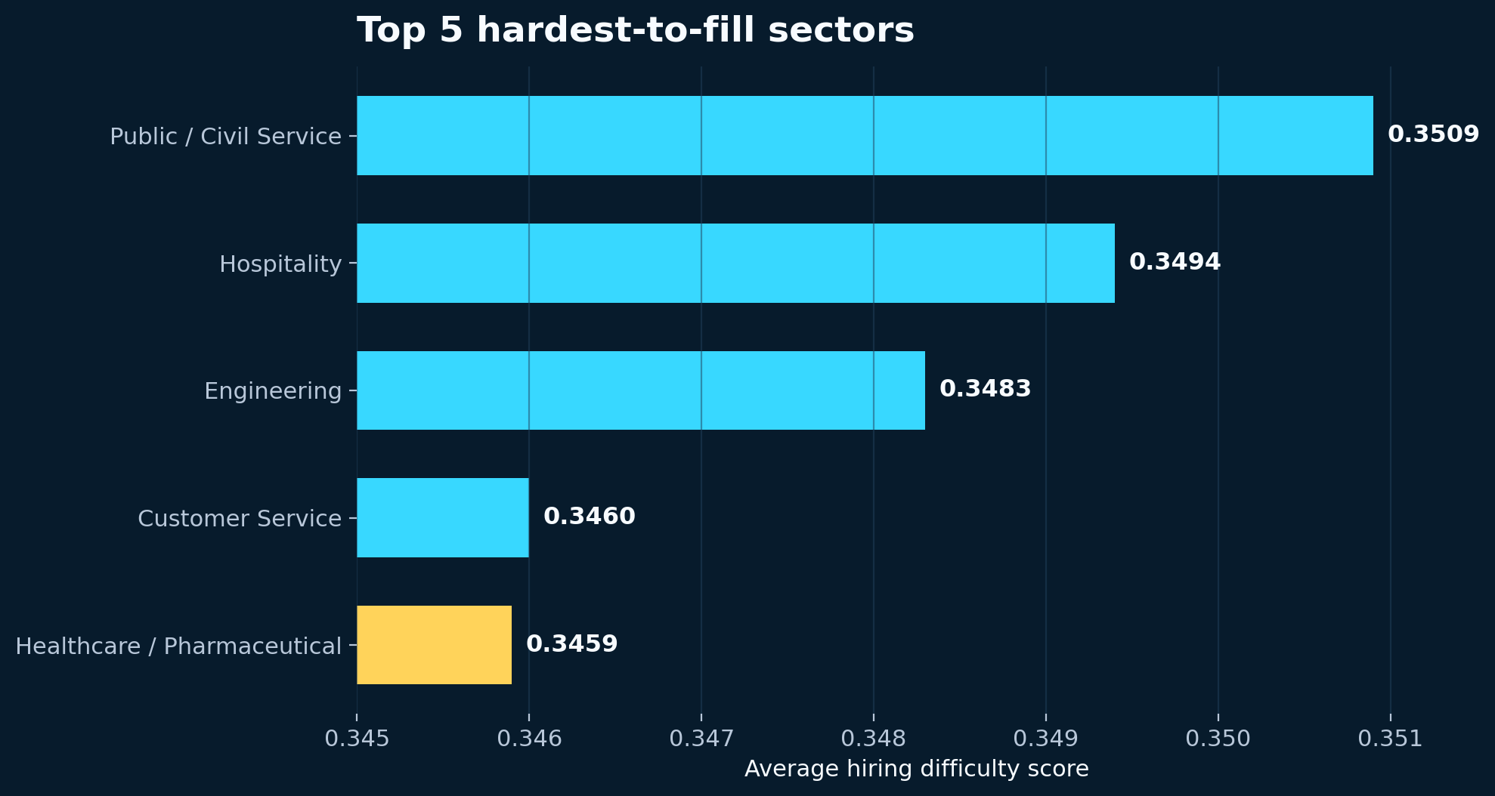
Top 5 Priority Sectors for Intervention
A focused view for grant and programme prioritisation
Policy reading
Sector
Score
Public / Civil Service
0.3509
Hospitality
0.3494
Engineering
0.3483
Customer Service
0.3460
Healthcare / Pharmaceutical
0.3459
Use this as the first shortlist for deeper employer-level validation and workforce intervention design.
Verified source: hackathon-team-5.ipynb
4:10–5:00 • 6/12
Notes:
Summary: - Narrow the sector analysis into an actionable top-five priority list. Main data highlights: - Top 5: Public / Civil Service, Hospitality, Engineering, Customer Service, Healthcare / Pharmaceutical. - Scores range from 0.3509 to 0.3459. Speaker points: - Explain that the sectors require different intervention types. - Hospitality and Customer Service may relate to job attractiveness and retention. - Engineering and Healthcare may require skills pipeline or conversion programmes. - Keep the message actionable and policy-oriented.

Slide 7
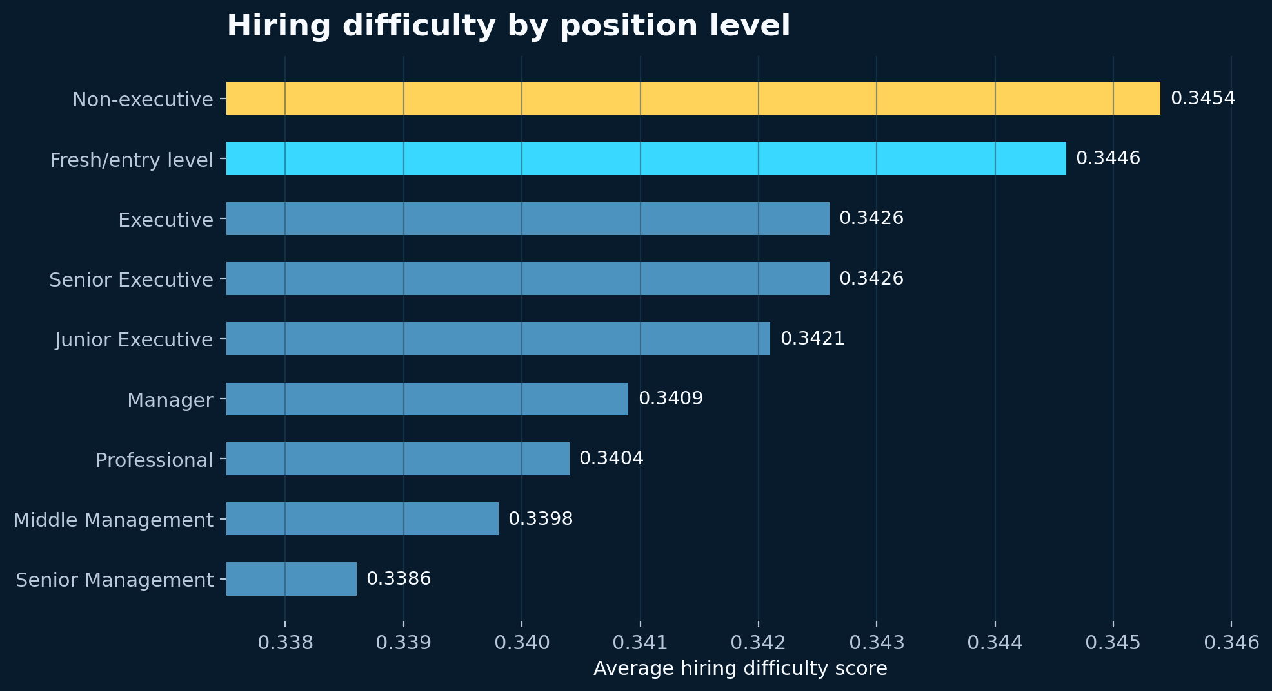
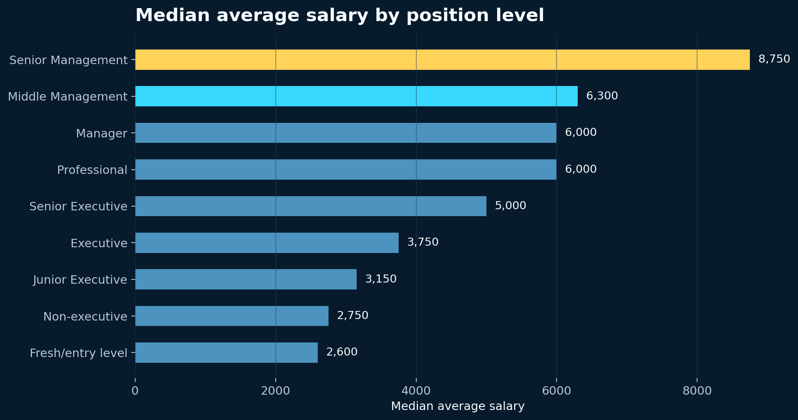
Insight 2: Position Level Affects Hiring Difficulty
Evidence challenges the assumption that senior roles are always hardest to fill
Non-executive and Fresh/entry level roles scored higher than Senior Management.
Surprising Finding
Common perception is that senior roles are harder to fill, data shows that entry level jobs are harder to fill.
Verified source: hackathon-team-5.ipynb
5:00–6:20 • 7/12
Notes:
Summary: - Show the second insight: lower-level roles have higher average difficulty scores. Main data highlights: - Non-executive: 0.3454. - Fresh/entry level: 0.3446. - Senior Management: 0.3386. Speaker points: - State clearly that the result is not what many people might expect. - Explain that structural hiring difficulty may also be a frontline workforce issue. - Avoid claiming causation; keep it as an observed pattern from the difficulty score.

Slide 8
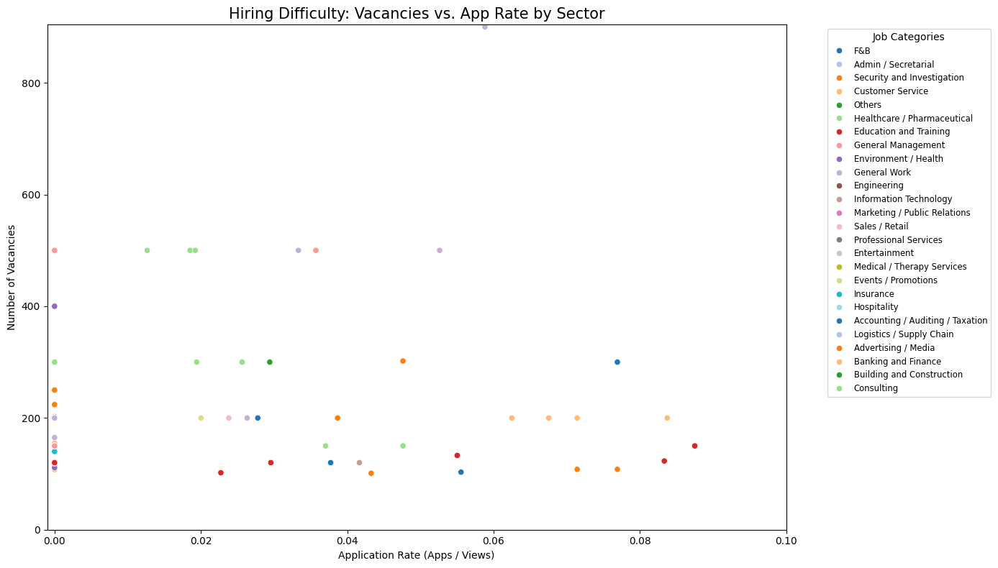
Insight 3: High Vacancies but Low Application Rate
Detecting supply–demand mismatch from application conversion
Code
E.g. Health care and general management are the job categories with high vacancies and low application rate
Application rate = applications ÷ views
High vacancy roles were filtered using numberOfVacancies > 100
Low application rate suggests weak candidate conversion
This flags potential supply–demand mismatch
Core calculation
df_clean['app_rate'] = df_clean['metadata_totalNumberJobApplication'] / df_clean['metadata_totalNumberOfView']
high_vacancy_df = df_clean[df_clean['numberOfVacancies'] > 100]
Verified source: hackathon-team-5.ipynb
7:00–8:15 • 9/12
Notes:
Summary: - Explain how the scatter plot identifies potential supply–demand mismatch. Main data highlights: - Application rate was calculated as applications divided by views. - High-vacancy roles were filtered using numberOfVacancies greater than 100. - The chart is from the notebook output. Speaker points: - Tell the audience that these roles may be seen by candidates but not converted into applications. - Use this as a policy signal for deeper investigation. - Do not name specific outlier roles unless they are clearly labelled and verified in the notebook.

Slide 9
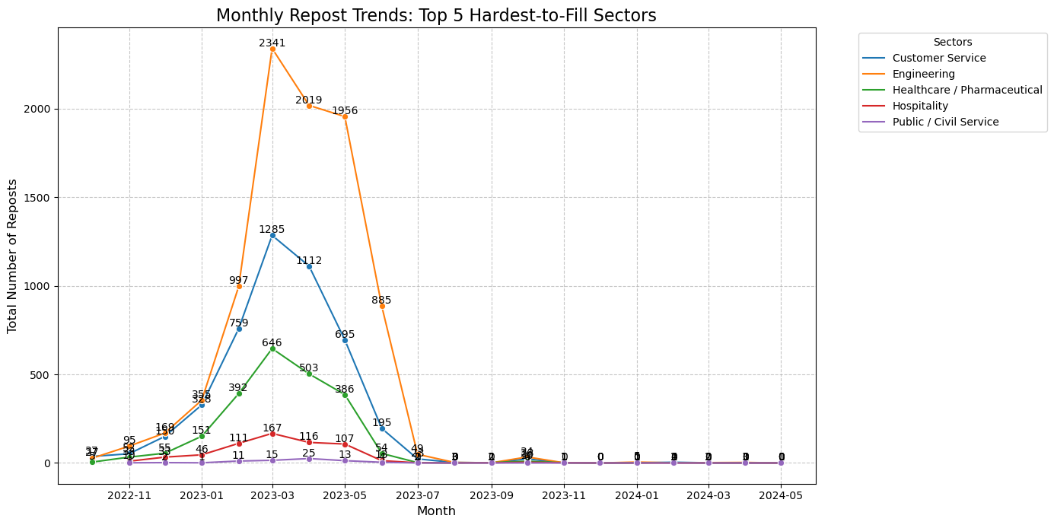
Monthly Repost Trends for Top 5 Sectors
Reposts help indicate where hiring pressure persists over time
Notebook logic
Identify the top 5 sectors using difficulty score
Filter the dataset to those sectors
Group by sector and month
Sum monthly repost counts
Plot the trend over time
Trend calculation
top_5_sectors = df_clean.groupby('primary_category')['hiring_difficulty_score'].mean().sort_values(ascending=False).head(5).index.tolist()
trends = df_top_5.groupby(['primary_category', pd.Grouper(key='metadata_originalPostingDate', freq='MS')])['metadata_repostCount'].sum().reset_index()
Verified source: hackathon-team-5.ipynb
8:15–9:00 • 10/12
Notes:
Summary: - Show that the notebook also examined repost trends over time for the top five sectors. Main data highlights: - Top 5 sectors are selected from the difficulty-score ranking. - Monthly repost counts are summed by sector. - The line chart is from the notebook output. Speaker points: - Explain that repost trends are useful because persistent reposting can indicate ongoing hiring pressure. - Avoid adding new numbers that are not printed in the notebook output. - Position this chart as supporting evidence rather than a standalone causal conclusion.

Slide 10
Data Caveats
What this analysis can and cannot conclude
Caveats to state clearly
How to use the analysis
Repost count is a proxy, not direct proof of failed hiring
Application volume does not measure candidate quality
Views and applications may be influenced by platform behaviour
Salary fields may not fully reflect total compensation
Dataset covers October 2022 to May 2024
Use the Hiring Difficulty Index as a prioritisation tool to decide where deeper sector-level and employer-level investigation should begin.
The analysis ranks likely areas of concern; it should be paired with policy judgement and employer validation.
Verified source: hackathon-team-5.ipynb
9:00–9:30 • 11/12
Notes:
Summary: - Demonstrate analytical maturity by acknowledging limitations. Main data highlights: - Repost count is a proxy measure. - Application volume does not measure applicant quality. - Dataset period is October 2022 to May 2024. Speaker points: - Frame limitations professionally, not defensively. - Say the index is a prioritisation tool rather than the final answer. - Transition to the recommendation.

Slide 11
Top 5 Priority Sectors for Intervention
Different sectors require different policy levers
1
Public / Civil Service
0.3509
Intervention design
2
Hospitality
0.3494
• Hospitality / Customer Service
Attraction, retention, job redesign
• Engineering / Healthcare
Longer-term skills conversion
• Public / Civil Service
Review role requirements and applicant fit
3
Engineering
0.3483
4
Customer Service
0.3460
5
Healthcare / Pharmaceutical
0.3459
Key takeaway: the top 5 sectors require differentiated policy levers rather than a generic retraining response.
top_5_sectors = difficulty_by_primary_category.head(5).index.tolist()
df_top_5 = df_clean[df_clean['primary_category'].isin(top_5_sectors)].copy()
Verified source: hackathon-team-5.ipynb
4:10–5:00 • 6/12
Notes:
Summary • This slide turns the top 5 ranking into policy priorities. Main data highlights • Top 5 sectors: Public / Civil Service, Hospitality, Engineering, Customer Service, Healthcare / Pharmaceutical. • Scores are close, ranging from 0.3509 to 0.3459. • The sector mix suggests different causes and different intervention types. Speaker points • Avoid presenting the ranking as a simple winner-takes-all result. • Explain that service sectors may need attraction and job redesign. • Explain that engineering and healthcare may need longer-term skills conversion and training pathways.

